Slide 1
UEN002 – Energy and Environment
In the previous session…
We had a glimpse of the most famous unfortunate disaster …. The Bhopal Gas Tragedy.

Slide 2
Love Canal Tragedy

Slide 3
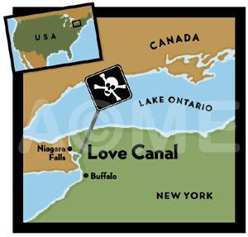
Where is Love Canal?
Love Canal is a section of Niagara Falls, NY near the Niagara river
The canal was part of a larger vision of William Love, who in 1892 dug up the area in order to allow water to flow through Niagara and produce a sprawling industrial city
After Tesla developed alternating current in the mid 1890’s investors pulled out leaving the Love Canal unfinished and basically a big ditch.

Slide 4
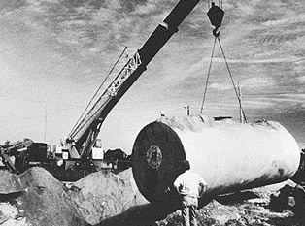
The Seeds of the problem
The Hooker Chemical Company bought the canal/ditch in 1940’s as a chemical dump site
Some 25,000 tons of chemicals were dumped in this ditch, at that moment there are no residents
In 1952, Hooker stopped dumping the chemicals and covered it with dirt

Slide 5
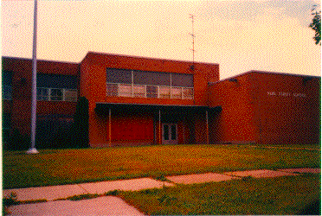
Mistakes are made…
The School Board of Niagara approached Hooker Chemical to sell the patch of land in and around Love Canal for a new school and a park
After much negotiation, Hooker sold the land for $1 telling the new owners about the dump underneath
The 99th Street School was constructed directly on top of the canal in 1953 and houses were build around the school

Slide 6
The rain comes…
Niagara Falls has a very high water table and 1976-77 was an unusually rainy year
That being said, residents began to notice chemicals leeching into their basements
The EPA, USA analyzed nearby basements and found benzene, a serious health risk as well as other chemicals such as chloroform

Slide 7
Few of the chemicals found in the basements of the residential area
2,3,7,8-tetrachlorodibenzo-p-dioxin
benzenehexachlorides
tetrachlorobenzenes
dichlorobenzenes
pentachlorbenzene
polychlorinated byphenyls (PCBs)
DDT
Toluene
chloroform
benzene
methylene chloride
lindane (hexachlorcyclohexane)
tetrachloroethylenes
trichloroethylene

Slide 8
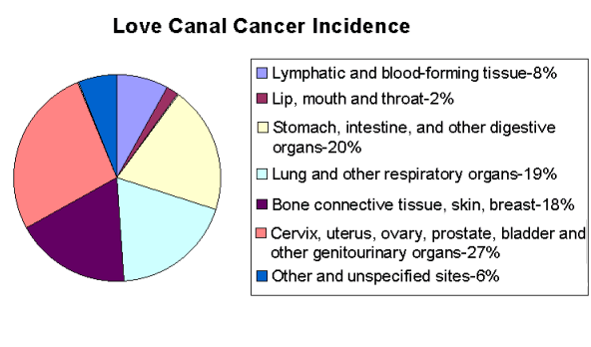
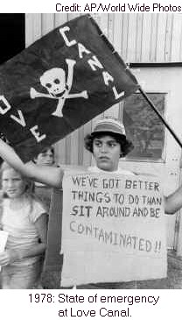

Slide 9
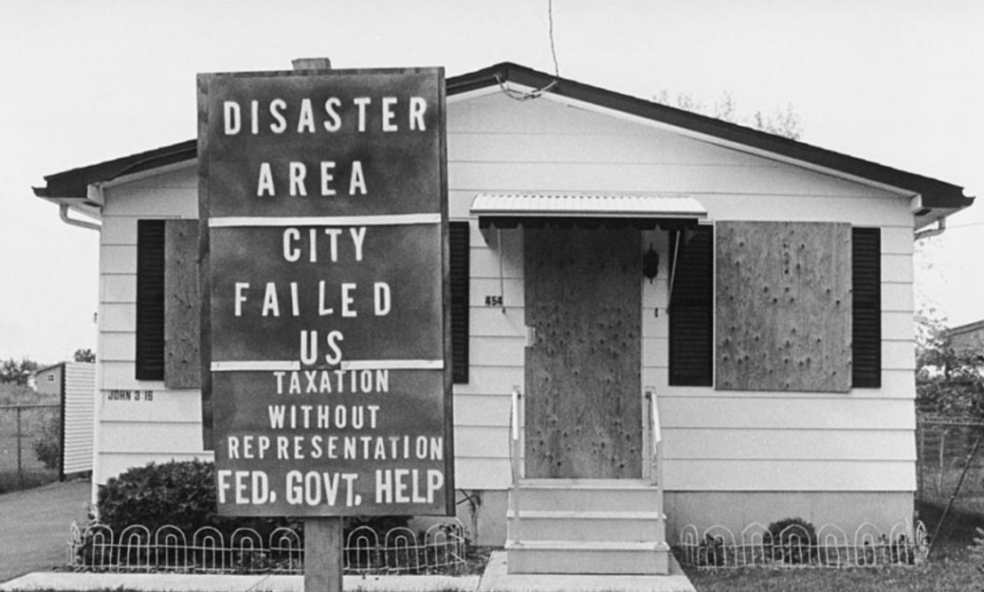
The Community Reacts
A very scared community begins to panic over the implications of these chemicals
Since there was never such a chemical spill before, the government has no idea what to initially do
After many discussions, government on August 7, 1978 pays to move the inner ring houses or the closest to the ditch to new homes
The canal was then remediated and capped so no chemical would leach out

Slide 10
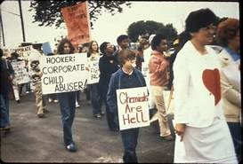
The Community Reacts
While the inner rings were evacuated, the outer rings were not initially
After 2 years of constant demonstrations and health studies about the nearby residents, the remaining residents were evacuated

Slide 11
At the end..
Love Canal showed the world that there is a real chemical threat from these dumps
While response teams trained in chemical spills are now in place, the residents of Love Canal were the victims of ignorance about chemicals and how to deal with them.
Congress drew on information from the Love Canal case when it debated and passed CERCLA, the Comprehensive Emergency Response, Compensation and Liability Act (known informally as the "Superfund" Act).

Slide 12
Beas River Pollution

Slide 13
Background
Punjab : Beas, Chenab, Jhelum, Ravi, and Sutlej
Usage: irrigation, drinking purpose, development of hydro-electric projects
Origin of River Beas: 460 km long originates from two sources, Beas Kund on the South and, Beas Rishi on the right of Rohtang Pass within North-Western Himalaya. The two streams meet at Palchan village, 10 km north of Manali to form river Beas
CONSERVATION RESERVE: Area of River Beas from 52 head Talwara to Harike Barrage

Slide 14
Sources of Water Pollution in River Beas
Major Drains
13 major drains/choes/nallahs
22 creeks/nallahs which are discharging into 02 major drains namely Kahnuwan Swamp Drain and Holy Bein
Urban and rural habitation: directly and indirectly
Major Sources
Sewage/ sullage generated from Urban Areas
Sewage/ sullage generated from Rural Area
Industrial Sources

Slide 15
Sources of Water Pollution in River Beas
Sewage/ sullage generated from Urban Areas: 16 local bodies, 6 MES authorities, 2 Industrial Focal Points, 01 Jalandhar Development Authority and one Industrial Complex of H.P.
Sewage/ sullage generated from Rural Area:75 Villages
17 Villages are having discharge more than 300 KLD
43 Villages having discharge between 100 KLD and 300 KLD
15 Villages having discharge less than 100 KLD
Industrial Sources: Brewery, Distillery, Sugar Mill, Paper Mill, Thermal Plant, Food Industry, Pharmaceuticals, Vanaspati, Health Care Facilities, Educational Institutes, Industrial Complex

Slide 16
Other Sources of Water Pollution in River Beas
Bio Medical Waste: 14-15 TPD, 4 authorized Common Bio-Medical Waste Treatment Facilities (CBWTF)
Hazardous Waste: Common Treatment, Storage and Disposal Facility(CTSDF) at Village Nimbuan, Tehsil DeraBassi
E-Waste: NOC/ ‘Consent to Operate’ to one dismantling facility, M/s Ramky Enviro Engineers Limited, Tehsil DeraBassi, with capacity to handle 4 TPD of E-waste
Solid Waste: Common Action Plan, Common Action Plan

Slide 17
Beas River: Pollution Episode
Sugar mill situated on its shore at Kiri Afgana village in Gurdaspur district.
As the mill is located next to a drain connected to the river, the impact was immediate. Within hours, locals started spotting dead fishes floating on the water.
In the morning of May 16, 2018 around 08:00 AM molasses from the sugar mill started leaking from storage tanks into the storm water drain.

Slide 18
Beas River: Pollution Episode
The sugar mill management failed to stop the leakage which continued for next 30 hours.
However, by that time Punjab’s wildlife department had found more than five varieties of fish that became victims of the spillage
The Punjab Pollution Control Board (PPCB) imposed a fine of Rs 5 crore and also initiated criminal proceedings against Chadha Sugar Mill for spill of molasses into the river Beas on May 17 that killed hundreds of fish and contaminated water for several kilometres, including in canals

Slide 19
Beas River: Pollution Episode
Mismanagement caused leakage:
Because of the bumper sugarcane yield, farmers’ protested in front of mill. The local administration asked the mill to take more sugarcane which was beyond its capacity.
The mill processed more crop, producing more molasses. The extra molasses was stored in the two tanks which were actually constructed for treated effluent
A molasses tank has to be equipped with facilities for re-circulation and for pumping the molasses from one storage tank to another. It should have an air injection system and adequate ventilation on the roof top

Slide 20
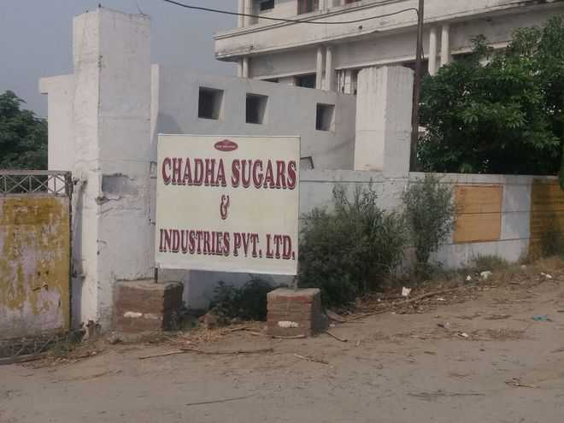
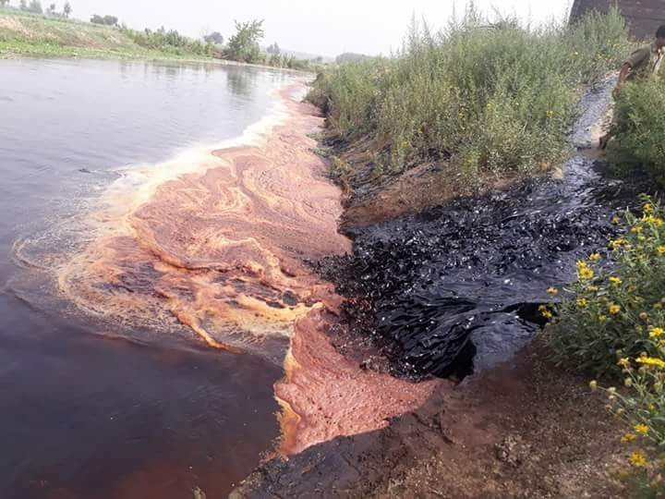
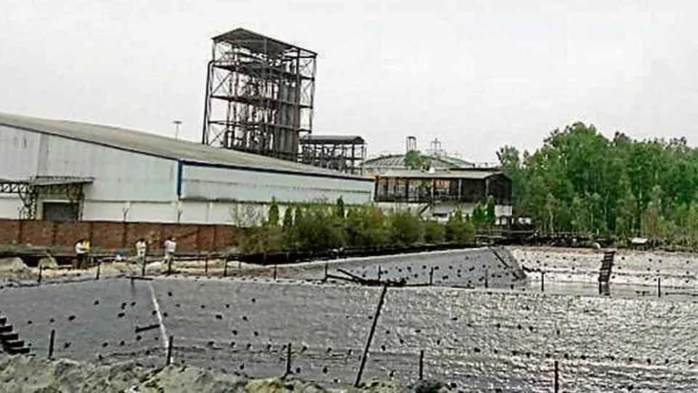
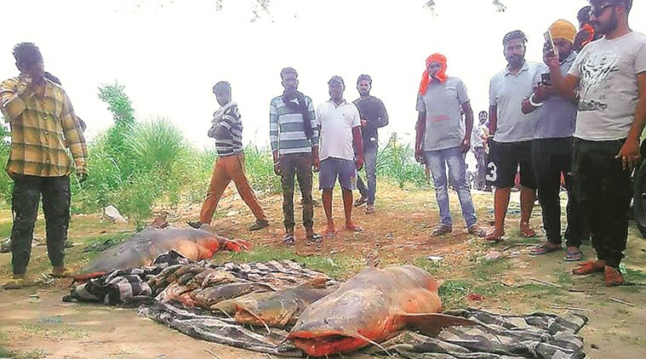

Slide 21
Beas River: Pollution Episode
Fatal Impact on Aquatic life
About 80-110 km stretch of river was affected
Water samples were tested at Ludhiana’s Punjab Agricultural University and Guru Angad Dev Veterinary and Animal Sciences University to ascertain if something else may also have been there.
To stabilize the situation, water was released from the Pathankot’s Ranjit Sagar Dam into the river. This was done to wash out the pollutants

Slide 22
Observations by National Green Tribunal
The industries and local Bodies failed to install and make functional the requisite treatment plants, 35 Municipal Corporations/Nagar Panchayats are discharging sewage with heavy metal and BOD loads in the Rivers
Despite PPCB efforts, the water quality did not meet the laid down standards
STPs were not having stand-by arrangement during maintenance
Industrial effluents are mixed up with the domestic sewage resulting in damage to the STPs

Slide 23
Directions Issued by National Green Tribunal
Secretary, Local Bodies, Punjab, the Municipal Commissioners of Ludhiana and Jalandhar, to jointly take responsibility for taking further steps to prevent any further damage
Prepare Action Plans within two months for bringing all the polluted river stretches to be fit at least for bathing purposes (i.e BOD <3mg/l and FC< 500 MPN/100 ml) within six months from the date of finalization of the action plans
Action plans may be prepared by 4 member Committee comprising Director, Environment; Director, Urban Development; Director Industries; Member Secretary, SPCB of concerned State (River Rejuvenation Committee)

Slide 24
In conclusion….
All the cases that you have viewed and will be viewing through self-study (Chernobyl and Seveso), are prominent examples that prompt us to realize the fact that there is need to ‘Educate the educated’, as all those involved in causing the disasters or events were educated enough to understand the impact.
These case studies exemplify the need to re-emphasize on awareness and knowledge of our planets valuable resources, the man-made impacts on these meagre resources and most importantly the solutions to mitigate the impact and rejuvenate the ecosystem through sustainable technologies and associated development.

Slide 25
In the next session…..
International Conventions that initiated the debates and agreements on Global Climate Change…..

